Slide 1
Gender Pay Gap Report
2025

Slide 2

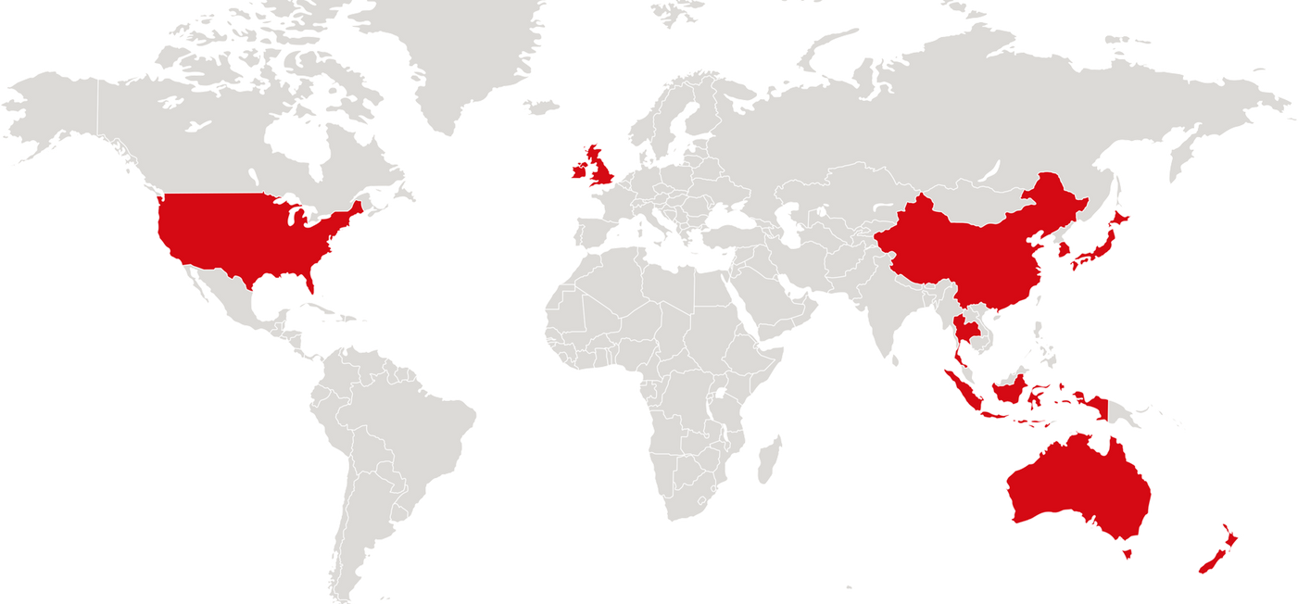


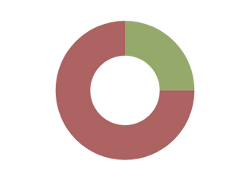
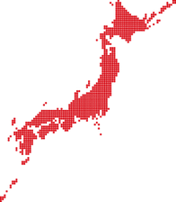


Calbee Inc - a global player in snacks & cereal
South Korea
#4
global savoury
snack company *¹
Ireland
United Kingdom
China
United States
Japan
Thailand
Hong Kong
Approx. 5,100 colleagues working out of 12 markets
Indonesia
Singapore
Australia
New Zealand
International
Japan
No.1
snack company
in Japan *²
Produce
approx. 2 billion
packets per year
US $2.1 billion
net sales in FY25
29 production sites
worldwide
*1 Source: Euromonitor International Limited; Snacks 2025ed, Global Brand Owner; Retail Value Sales; 2024 data
*2 INTAGE Inc. SRI+, Nationwide / All Retail Channels, Based on Sales Amount, Fiscal Year Ending March 2025: April 2024 – March 2025
Copyright © Calbee, Inc. All Rights Reserved.

Slide 3
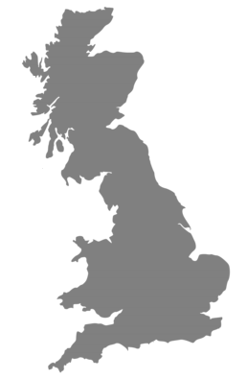


Calbee Group UK
Snacks - Deeside
Established 2015
Crisps & HQ - Bradford
Established 1945
#4
Global savoury
snack company *¹
269 UK employees
Snacks
No.5
savoury snack company in UK*
Crisps
Produce
Over 500 million
packets per year
UK £75m
net sales in FY25
2 UK production sites
Bradford & Deeside
*1 Source: Euromonitor International Limited; Snacks 2025ed, Global Brand Owner; Retail Value Sales; 2024 data
* Kantar 52 w/e 30 Nov 2025
Copyright © Calbee, Inc. All Rights Reserved.

Slide 4

Calbee Group UK Gender Pay Gap Report
The information outlined in this document is based on our second gender pay gap report.
This report highlights the progress we have made as we continue to strive for equity within our organisation.
Compared with 2024, there has been a reduction in the mean and median gender pay gap, as well as the mean bonus pay gap.
Calbee Group UK remains committed to fostering a fair and inclusive workplace, and to monitoring our progress as we move forward.
We fully embrace this responsibility and see it as an opportunity to further demonstrate our commitment to transparency and equality throughout our business.

Slide 5
Our Gender Pay Gap Results
About Gender Pay Gap Data
Our Workforce
In 2017, the UK implemented Gender Pay Gap Regulations, which require all employers with 250 or more employees to report gender pay gap data on an annual basis. This data measures the difference between the average hourly pay of men and women on the snapshot date (5 April 2025 in this case), regardless of role or seniority. The reported data includes:
Mean and median gender pay gap
Mean and median gender bonus gap (based on bonuses earned in 12 months ending 5 April 2025)
The proportion of men and women receiving bonuses
41% of our workforce is female, which is significantly above
average for the manufacturing sector
 | Mean | Median
Gender Pay Gap | 23.8% | 3.6%
Bonus Pay Gap | 45.3% | -
100% of our workforce receives a bonus
Female Male

